Slide 1
Using RFT to train complex emotion recognition skills
Kerry C. Whiteman, Karen Kate Kellum, Kelly Wilson, & Michael Bordieri
Notes:
This study explored a new behavioral intervention based on relational
frame theory for training emotion recognition skills in children on the
autism spectrum. Previous research on emotion recognition
interventions for this population has demonstrated limited
generalization of trained skills to novel emotion stimuli. The
application of relational frame theory to interventions has been shown
to be an efficient and effective way of producing generalized behaviors
in both typically developing and developmentally delayed populations.
Using a concurrent multiple probe design across participants, this
study investigated whether the incorporation of derived relational
responding into emotion recognition training for children on the autism
spectrum can address some of the limitations of other approaches.
Results of the training will be presented, and implications for future
development in this area will be explored.
Learning Objective: Describe the preliminary findings from an RFT
based task designed to train complex emotion recognition.

Slide 3
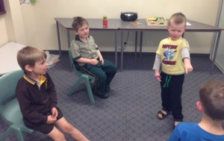
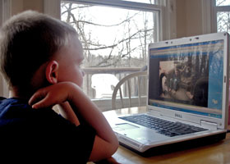
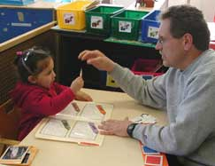
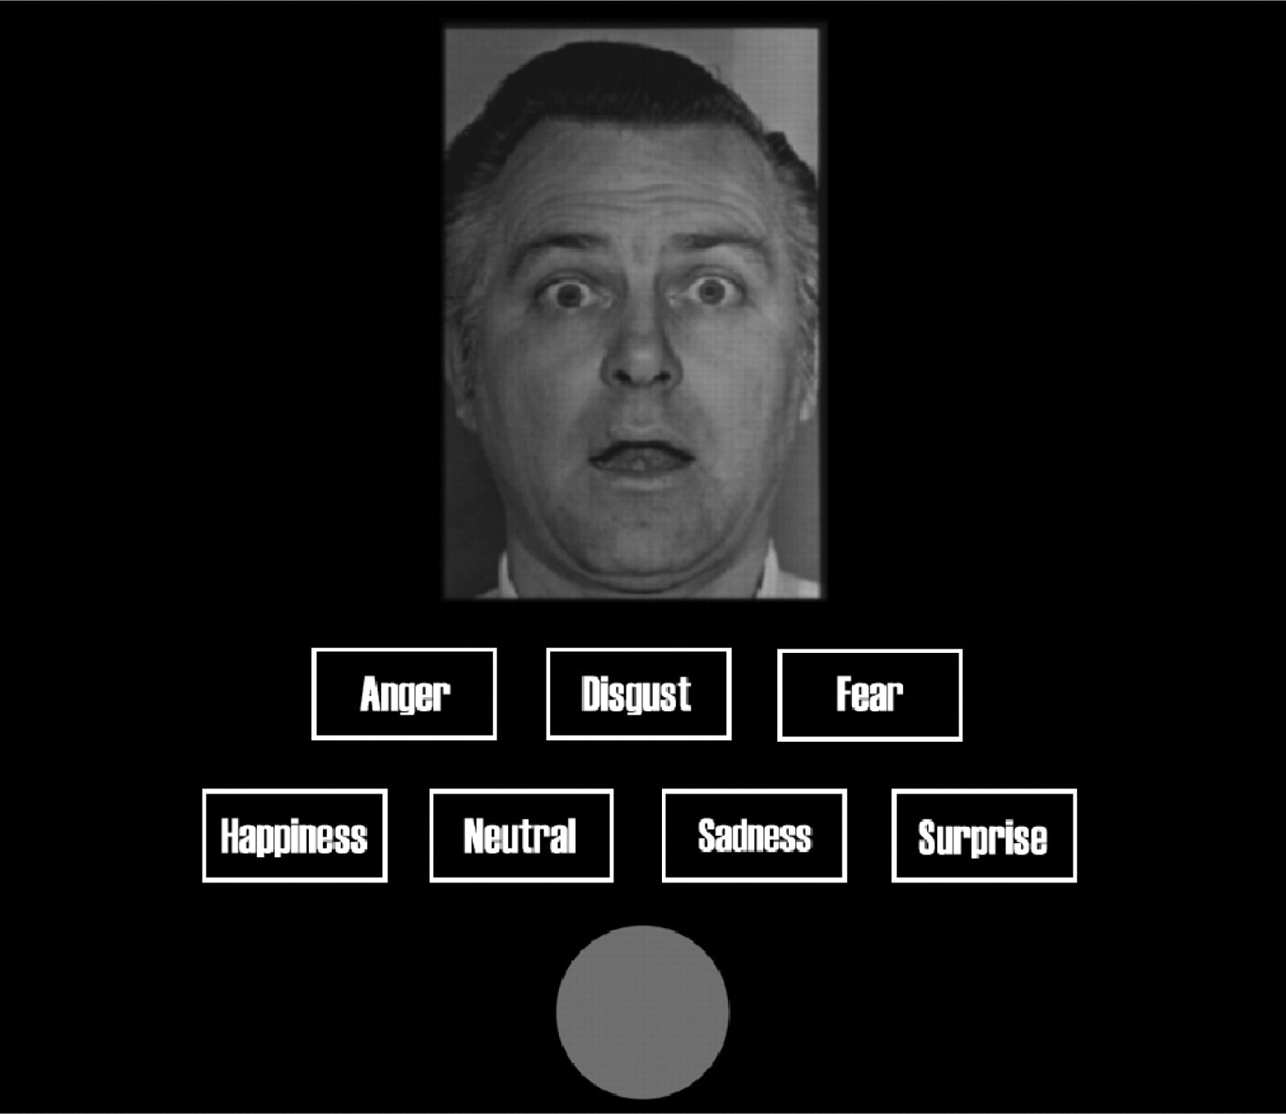
Notes:
What’s been done to address it: labeling static pictures
labeling brief video clips--technology/computer programs/television shows
teaching short stories
part of a group social skills training course--indirectly taught but refer to certain body postures and physical behaviors while teaching overall appropriate behavior for a given situation

Slide 4
Facial Expression (FE)
Body Posture (BP)
Appropriate Response
Context
A
Derived Relational Responding
Emotion Label
B
C
Notes:
What procedure using and why RFT might help

Slide 5
angry
angry
sad
happy

Slide 6
1.
2.
3.
4.
1. Identify Emotions
2. Develop Stimuli
3. Compound Stimuli
4. Preliminary Findings
Notes:
Outline for presentation
Identifying the emotions to be trained
Developing the stimuli
Creating the compound stimuli
Preliminary findings

Slide 7
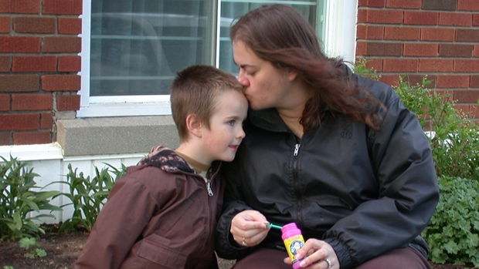
1: Identify Emotions
Notes:
Came from talking with parents about the specific emotions and contexts that their kids had difficulty with
Examples?

Slide 8
Notes:
Came from talking with parents about the specific emotions and contexts that their kids had difficulty with
Examples?

Slide 9
2: Stimuli Development
Notes:
Stimuli development
Creative commons for non-copyrighted pictures that could be used by consumers
Research assistants
Types of stimuli obtained
survey

Slide 10
You explain to your friend how to play a game.
9
18
9
Notes:
Survey rating-→ individual stimuli: 9 FE & 9 BP for each emotion; 18 contexts for all 4 emotions: Bored, Confused, Frustrated, Worried

Slide 11
Notes:
Mean=78

Slide 12
Notes:
Add means to histogram
Mean=76

Slide 13
Notes:
Mean=62

Slide 15
Source | df | F | Sig.
Emotion | 3 | 5.186 | 0.002
Type | 2 | 5.878 | 0.004
Emotion * Type | 6 | 2.357 | 0.034

Slide 16
P=.003
P=.06
P=.011
Notes:
emotion

Slide 17
P=.043
Your sister looks up as an ambulance drives by.
P=.003
Notes:
type

Slide 18
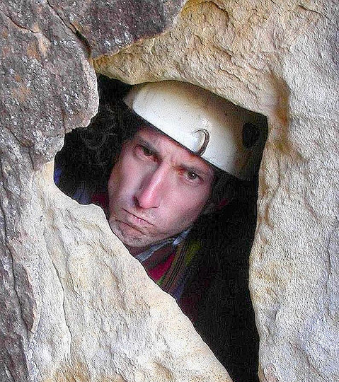
3: Compound Stimuli
Your uncle is trying to learn rock climbing.
Notes:
Developing compound stimuli

Slide 19
Minor Changes In Context for Coherence
Median Split for context, FE & BP
Alternated difficulty
Easy Context + Difficult Image
Difficult context + Easy Image
Notes:
9 images for FE and 9 for BP; no even split
Counterbalanced Number Across Image Type
5 easy FE, 4 easy BP in 2 of 4 emotions

Slide 20
Notes:
Bin it

Slide 22
Notes:
Differential pattern between the types of compound stimuli only holds up for
Error bars?

Slide 23
Source | df | F | Sig.
Emotion | 3 | 3.935 | 0.012
Type | 1 | 1.48 | 0.228
Emotion * Type | 3 | 0.959 | 0.418
Notes:
Levene’s test of homogeneity was non-significant @ p=.192

Slide 24
I’m frustrated!
P=.008

Slide 25
angry
angry
sad
happy

Slide 26
Notes:
Bin it

Slide 27
Mean > 75% correct
Minor Changes for Coherence
FE + BP → appropriate response
Randomized into 1 of 5 sets
Notes:
starting with the closet to 75% and working up; if there were ties (i.e., multiple rated at the top value) then a random number generator was used to determine what made the set
after randomization, several small changes were made to ensure that the stimuli formed coherent sets (FE + BP → same appropriate response)
even after the changes, there were no significant differences between groups (i.e. sets, emotions and type)

Slide 28
Ask “Did what I just say make sense?”
Say “Hey. How are you doing?”
Say “I hope everything turns out okay”
Say “I’m sorry. I’ll make it right”
Notes:
Examples of appropriate responses

Slide 29
Notes:
Error bars

Slide 30
Source | df | F | Sig.
Emotion | 3 | 2.122 | 0.117
Type | 1 | 2.79 | 0.105
Set Assigned | 4 | 0.749 | 0.57
Notes:
Levene’s test is non-significant and none of the interaction terms were significant either

Slide 31
4: Preliminary Findings
Notes:
Screening

Slide 32
Screening
Consent & Assent
Peabody Picture Vocabulary Test-4
Kaufmann Test of Educational Achievement -2
Emotion MTS Task
Reading Subtest
Control DRR Task
Notes:
3 participants

Slide 33
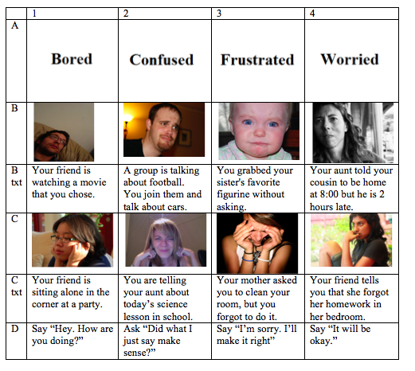

Slide 34
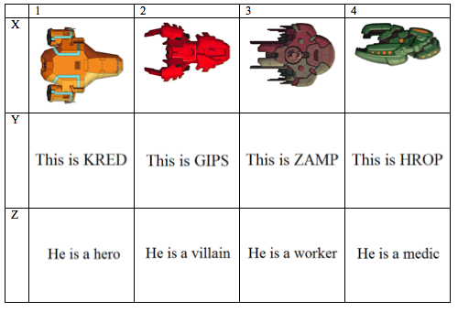

Slide 35
Hank
Fred
12 years old Caucasian male
Chuck
15 year old Caucasian male
Autism Spectrum Disorder
Autism Spectrum Disorder
13 year old Caucasian male
Autism Spectrum Disorder
Fred
Hank
15 years old Caucasian male
Chuck
12 year old Caucasian male
Autism Spectrum Disorder
Autism Spectrum Disorder
14 year old Caucasian male
Autism Spectrum Disorder
Notes:
Standard scores with a mean of 100 and a SD of 15
Parent reported social skills

Slide 36
Hank
Fred
12 years old Caucasian male
Chuck
15 year old Caucasian male
Autism Spectrum Disorder
Autism Spectrum Disorder
13 year old Caucasian male
Autism Spectrum Disorder
Receptive Vocab: 94
Reading: 93
Social Skills: 67
Fred
Hank
15 years old Caucasian male
Chuck
12 year old Caucasian male
Autism Spectrum Disorder
Autism Spectrum Disorder
14 year old Caucasian male
Autism Spectrum Disorder
Notes:
Standard scores with a mean of 100 and a SD of 15
Parent reported social skills

Slide 37
Hank
Fred
12 years old Caucasian male
Chuck
15 year old Caucasian male
Autism Spectrum Disorder
Autism Spectrum Disorder
13 year old Caucasian male
Autism Spectrum Disorder
Receptive Vocab: 94
Receptive Vocab: 93
Reading :93
Social Skills: 67
Reading: 96
Social Skills: 70
Fred
Hank
15 years old Caucasian male
Chuck
12 year old Caucasian male
Autism Spectrum Disorder
Autism Spectrum Disorder
14 year old Caucasian male
Autism Spectrum Disorder
Notes:
Standard scores with a mean of 100 and a SD of 15
Parent reported social skills

Slide 38
Hank
Fred
12 years old Caucasian male
Chuck
Social Skills: 62
15 year old Caucasian male
Autism Spectrum Disorder
Social Skills: 67
Autism Spectrum Disorder
13 year old Caucasian male
Autism Spectrum Disorder
Social Skills: 70
Receptive Vocab: 94
Receptive Vocab: 93
Receptive Vocab: 130
Reading: 93
Reading: 96
Reading : 116
Fred
Hank
15 years old Caucasian male
Chuck
12 year old Caucasian male
Autism Spectrum Disorder
Autism Spectrum Disorder
14 year old Caucasian male
Autism Spectrum Disorder
Notes:
Standard scores with a mean of 100 and a SD of 15
Parent reported social skills

Slide 39
Hank
Emotion Task
50% Correct
Control Task
100% Correct

Slide 40
Fred
Emotion Task
38% Correct
Control Task
100% Correct

Slide 41
Chuck
Emotion Task
56% Correct
Control Task
94% Correct

Slide 42
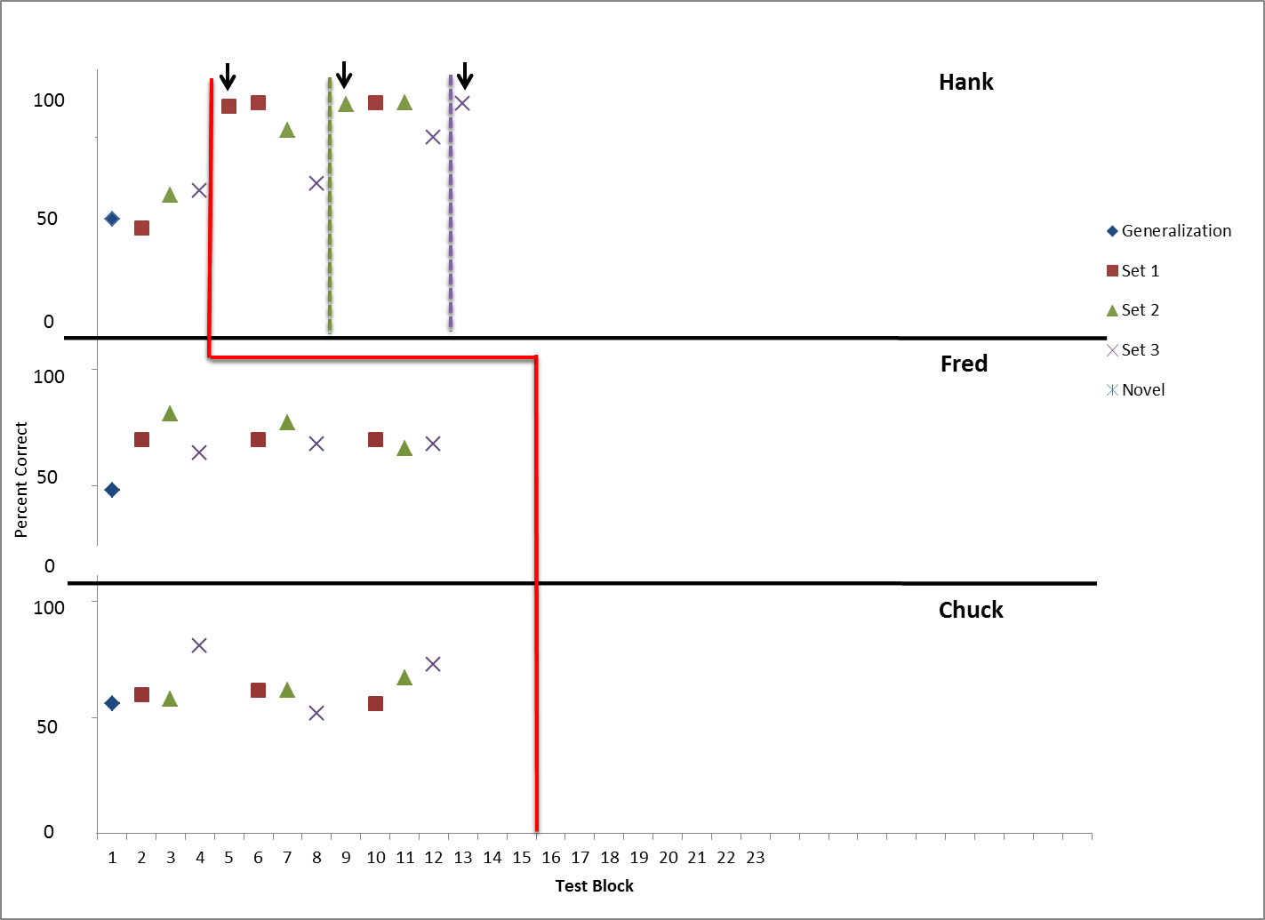

Slide 43
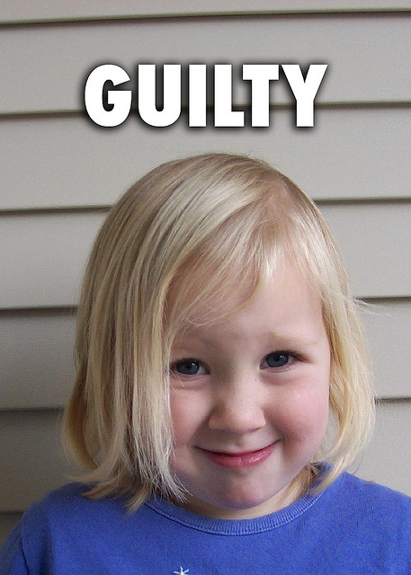
Summary
A
Derived Relational Responding
B
C

Slide 44
Future Directions
Notes:
Intervention is so far so good
Procedure to use to create idiographic ER interventions & to train other relevant stimuli

Slide 45
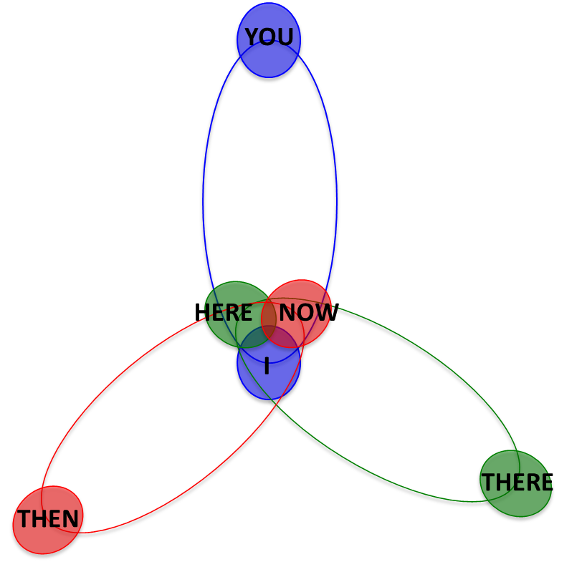
Future Directions

Slide 46
Using RFT to train complex emotion recognition skills
Kerry C. Whiteman, Karen Kate Kellum, Kelly Wilson, & Michael Bordieri
Notes:
This study explored a new behavioral intervention based on relational
frame theory for training emotion recognition skills in children on the
autism spectrum. Previous research on emotion recognition
interventions for this population has demonstrated limited
generalization of trained skills to novel emotion stimuli. The
application of relational frame theory to interventions has been shown
to be an efficient and effective way of producing generalized behaviors
in both typically developing and developmentally delayed populations.
Using a concurrent multiple probe design across participants, this
study investigated whether the incorporation of derived relational
responding into emotion recognition training for children on the autism
spectrum can address some of the limitations of other approaches.
Results of the training will be presented, and implications for future
development in this area will be explored.
Learning Objective: Describe the preliminary findings from an RFT
based task designed to train complex emotion recognition.

